Slide 1
JAVASCRIPT
INTRODUCTION TO JAVASCRIPT

Slide 2
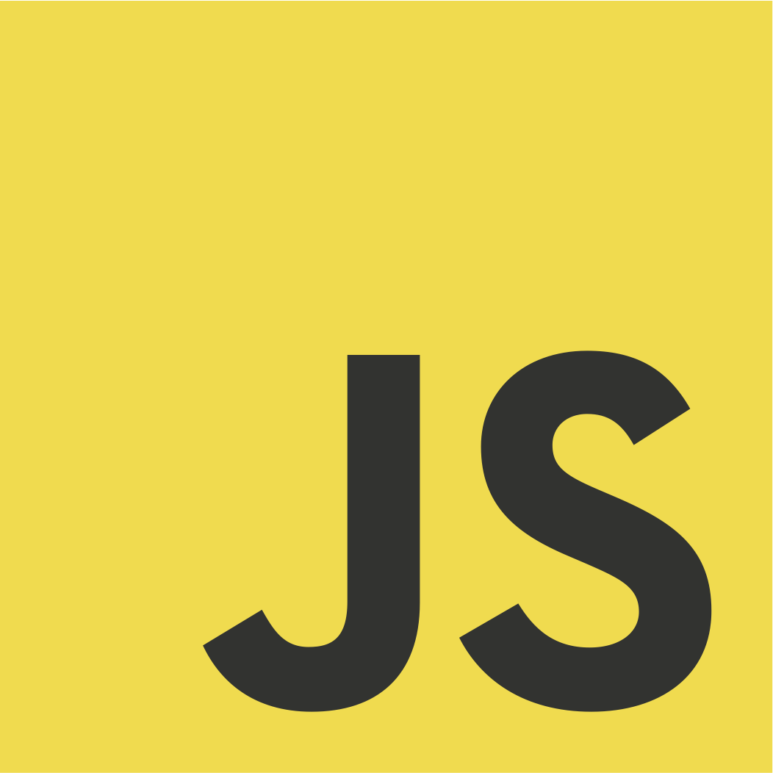
WHAT IS JAVASCRIPT?
JavaScript is a lightweight, cross-platform, and interpreted compiled programming language which is also known as the scripting language for webpages

Slide 3
DEFINITION OF CONCEPTS
Lightweight
Cross Platform
because it has low CPU usage, is incredibly easy to implement, and has a minimalistic syntax
Because of it’s ability to be used to develop application for different platforms and still work properly

Slide 4
DEFINITION OF CONCEPTS
Interpreted Compiled Language
Scripting Language
Earlier versions of JS, used only the interpreter that executed code line by line and shows the result immediately, This became quite slow. So, newer versions of JS introduced the JIT compiler to optimize the execution.
JS is a scripting language because it is interpreted and executed one command at a time

Slide 5
Features of JavaScript
JavaScript is an Object oriented programming language, i.e it is centered around objects
Syntax is similar to C programming language
It is used in
Client side – Traditionally used on browsers
Server Side – thanks to NodeJs, JavaScript now runs on the server.
It was initially only used for browsers and web pages, but it has spread to many other environments and applications.
It is platform-independent and case- sensitive.
JavaScript is extremely popular and frequently used in
Website creation
Mobile Applications
Interactive games
IOT devices
Drones
Virtual Reality

Slide 6
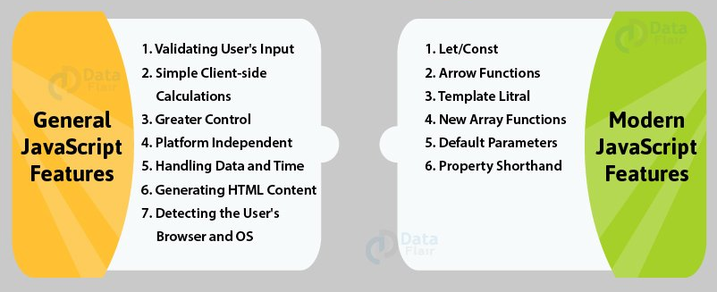
Features of JavaScript

Slide 7
Pre-requisites
No prior knowledge of programming is needed for the course.
You should know the basics of HTML and CSS, both of which are extremely easy to learn
Code Editors or IDE : for writing e.g.. VsCode, Atom, Sublime text
Browsers with JavaScript enabled. Chrome, Firefox e.t.c
Computer with the following specification
Window, MAC or Linux O.S
Processor: x86 or x64
HDD of 8GB or More
RAM of 512MB or more
Online Editors:

Slide 8
02
FUNDAMENTALS OF JAVACRIPT

Slide 9
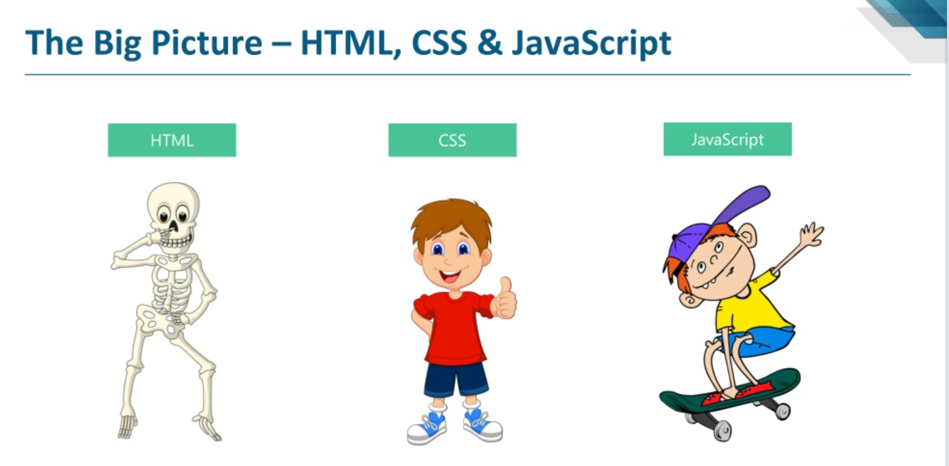

Slide 10
How JavaScript works
JavaScript can execute in the browser, the server, or any device that has
the JavaScript engine.
The browser has an embedded engine sometimes called a “JavaScript virtual machine”.
Different engines have different “codenames”. For example:
V8 – in Chrome, Opera and Edge.
SpiderMonkey – in Firefox.
…there are other codenames like “Chakra” for IE, “JavaScriptCore”, “Nitro” and “SquirrelFish” for Safari, etc.
The engine reads (“parses”) the script.
Then it converts (“translates”) the script to the machine language.
And then the machine code runs, pretty fast.
The engine applies optimizations at each step of the process. It even watches the compiled script as it runs, analyzes the data that flows through it, and further optimizes the machine code based on that knowledge.

Slide 11
OVERVIEW
How is JS included
Comments
JAVASCRIPT
Alert, Prompt & Console
Simple Hello World Program
~~

Slide 12
How is Javascript added to your Web file
Internal JS: We can add JavaScript directly to our HTML file by writing the code inside the <script> tag. The <script> tag can either be placed inside the <head> or the <body> tag according to the requirement.
External JS: We can write JavaScript code in other file having an extension.js and then link this file inside the <head> tag of the HTML file in which we want to add this code.

Slide 13
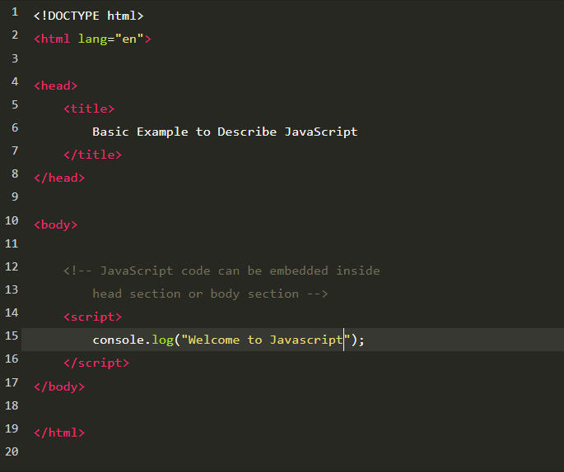
Syntax for Internal JS
<!DOCTYPE html>
<html lang="en">
<head>
<title>
Basic Example to Describe JavaScript
</title>
</head>
<body>
<!-- JavaScript code can be embedded inside head section or body section -->
<script>
console.log("Welcome to GeeksforGeeks");
</script>
</body>

Slide 14
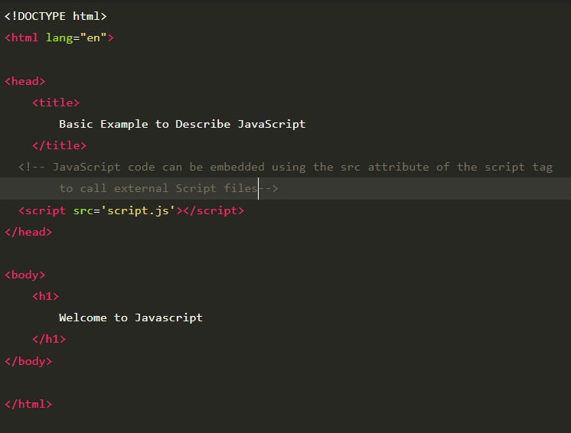
Syntax for External JS
<!DOCTYPE html>
<html lang="en">
<head>
<title>
Basic Example to Describe JavaScript
</title>
</head>
<body>
<!-- JavaScript code can be embedded inside head section or body section -->
<script>
console.log("Welcome to GeeksforGeeks");
</script>
</body>

Slide 15
Getting response from Script

Slide 16
Alert, Prompt & Console
Alert is a window property that sends a popup message to the users browser.
alert() OR window.alert();
Prompt asks for user’s input.
prompt(question, defaultValue) prompt(“How are you doing?”, “Fine, Thank you”);
Console is used to display output on the browser’s console or a JavaScript Console

Slide 17
Comments
These are used to leave notes in our code without it being in the way and its never executed.
Types are
Single Line :
// this is a comment
Multiline:
/* comment comment comment */

Slide 18
Demonstrate Hello World programming using Alert, Prompt & Console

Slide 19
Variables and Constants

Slide 20
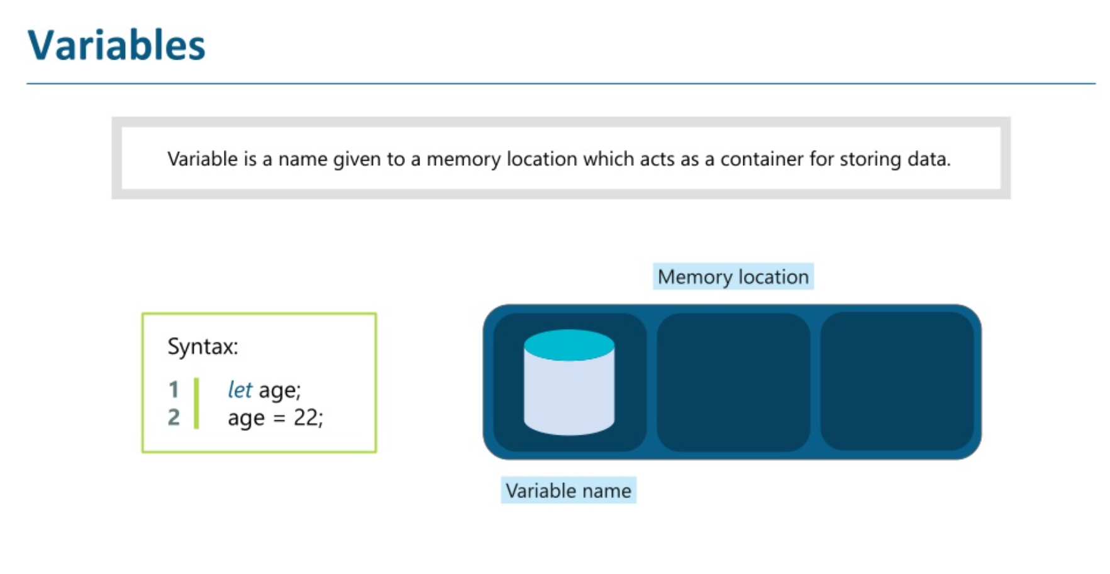

Slide 21
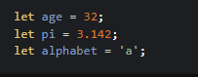
Variables
Variables are simply names that hold data.
It is to store information that can be changed, copied or removed.
We can use the var or let keywords to declare a variable
A variable name can either start with a letter, underscore or dollar sign and NO spaces

Slide 22
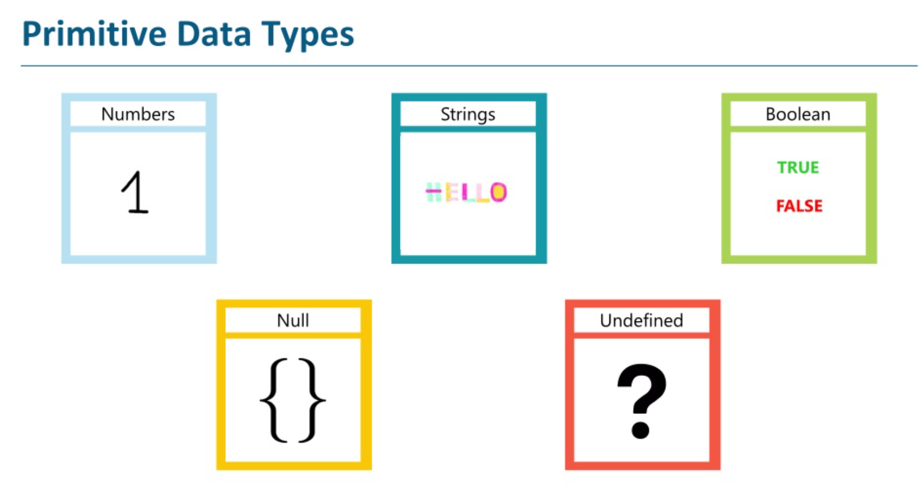

Slide 23
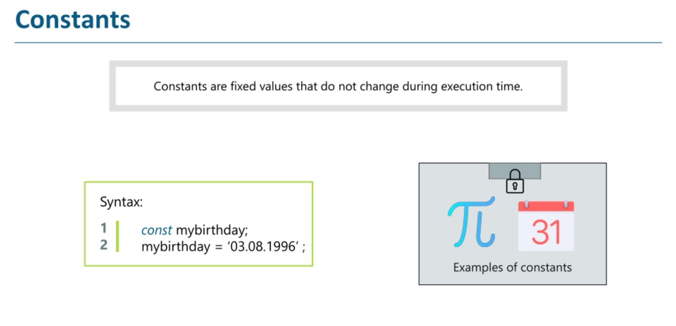

Slide 24
JAVASCRIPT OPERATORS

Slide 25
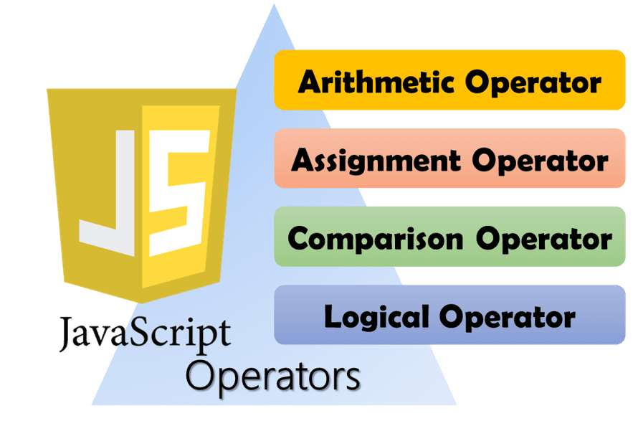

Slide 26
JAVASCRIPT OPERATORS
An operator is one or more characters that represents a computation like addition, multiplication, or division.
The values an operator works on are called operands.
When a variable name appears in the place of an operand, it is replaced with the value that it refers to before the operation is performed

Slide 27
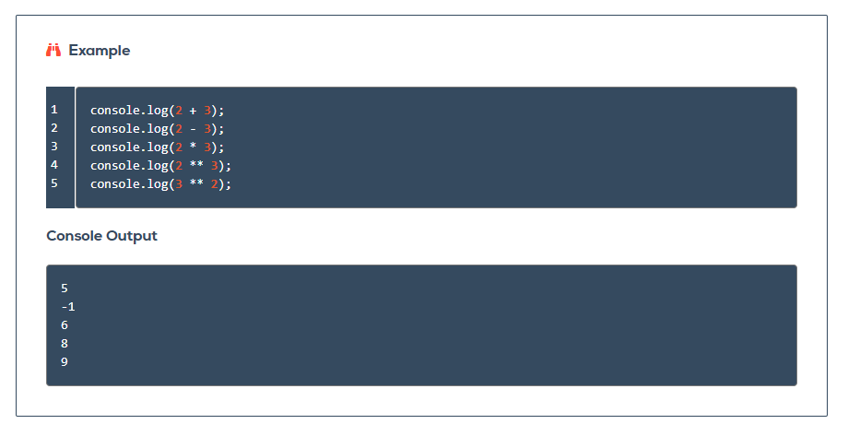

Slide 28
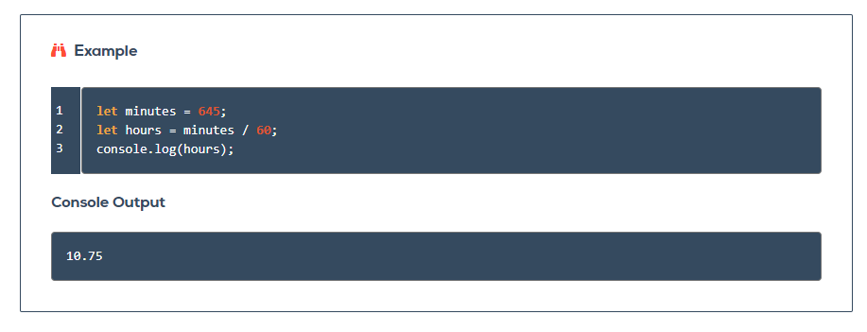

Slide 29
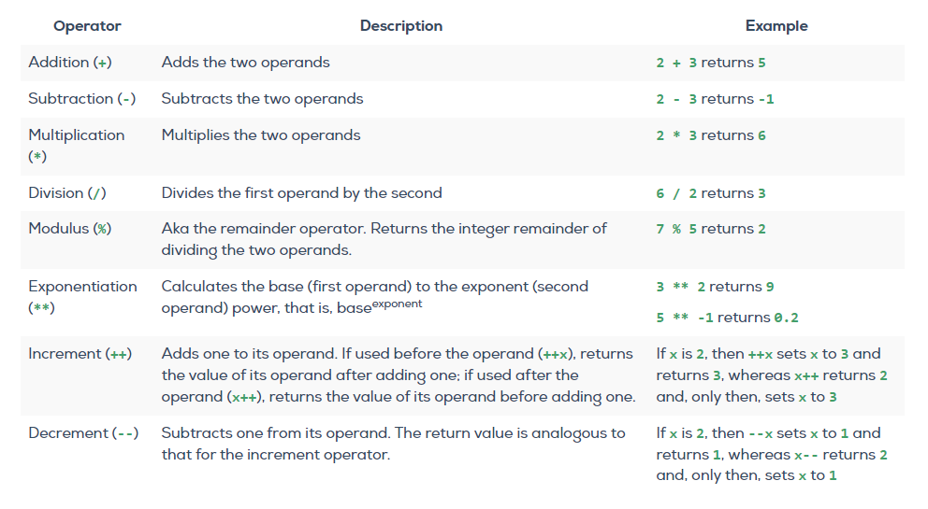
1. ARITHMETIC OPERATORS
Some of most commonly-used operators are the arithmetic operators, which carry out basic mathematical operations.

Slide 30
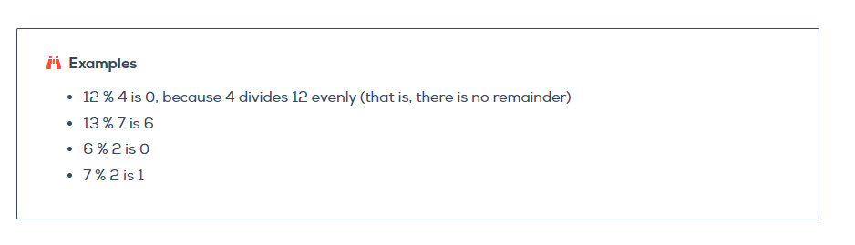
Modulus OPERATOR
While the modulus operator (%) is common in programming, it is not used much outside of programming

Slide 31
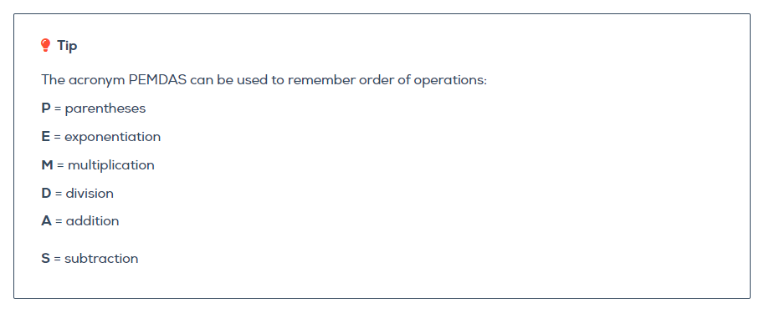
Order of Arithmetic Operators
When more than one operator appears in an expression, the order of evaluation depends on the rules of precedence. JavaScript follows the same precedence rules for its arithmetic operators that mathematics does

Slide 32
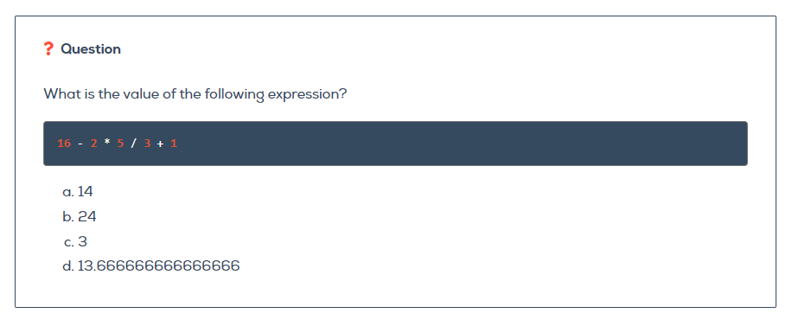
1. ARITHMETIC OPERATORS
Knowledge Check

Slide 33
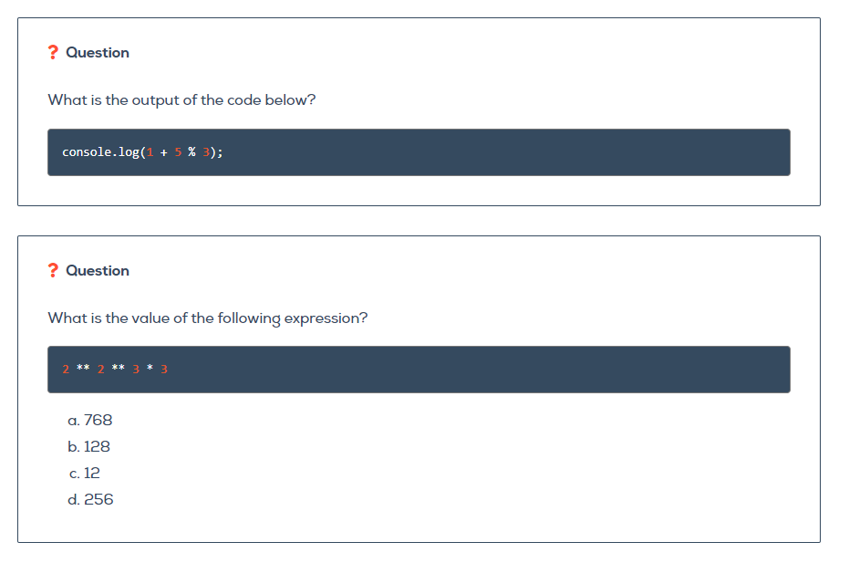
1. ARITHMETIC OPERATORS
Knowledge Check

Slide 34
1. ARITHMETIC OPERATORS
Knowledge Check

Slide 35
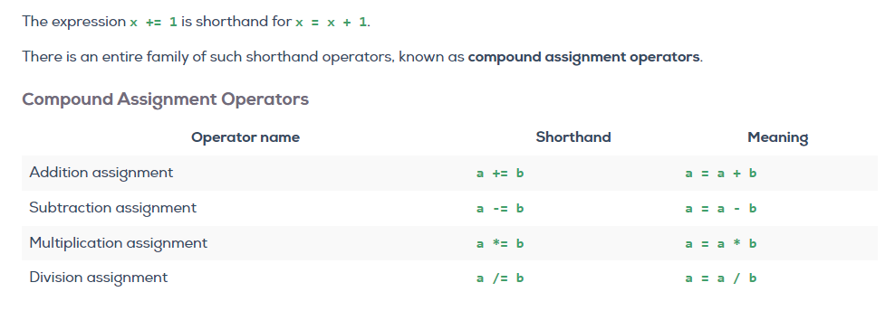
2. ASSIGNMENT OPERATORS
A common programming task is to update the value of a variable in reference to itself.

Slide 36
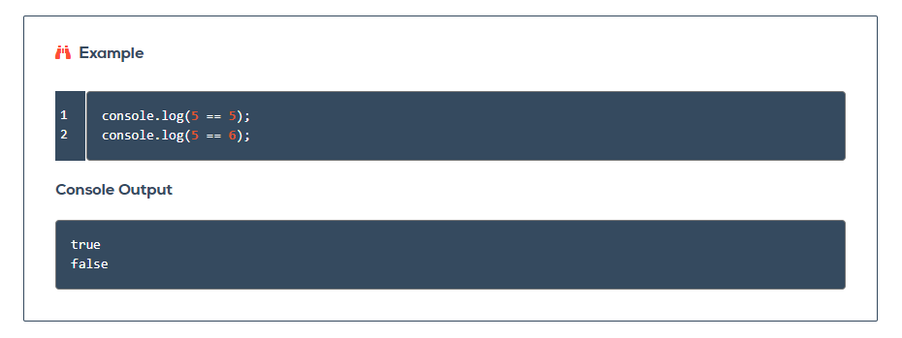
3. COMPARISON OPERATORS
A comparison operator compares its operands and returns a boolean value (true or false) based on whether the comparison is true
If the two operands are not of a different type, JavaScript tries to convert them in the same data type for the comparison.
Boolean expressions are used in comparisons
A Boolean expression is an expression that evaluates to either true or false.

Slide 37
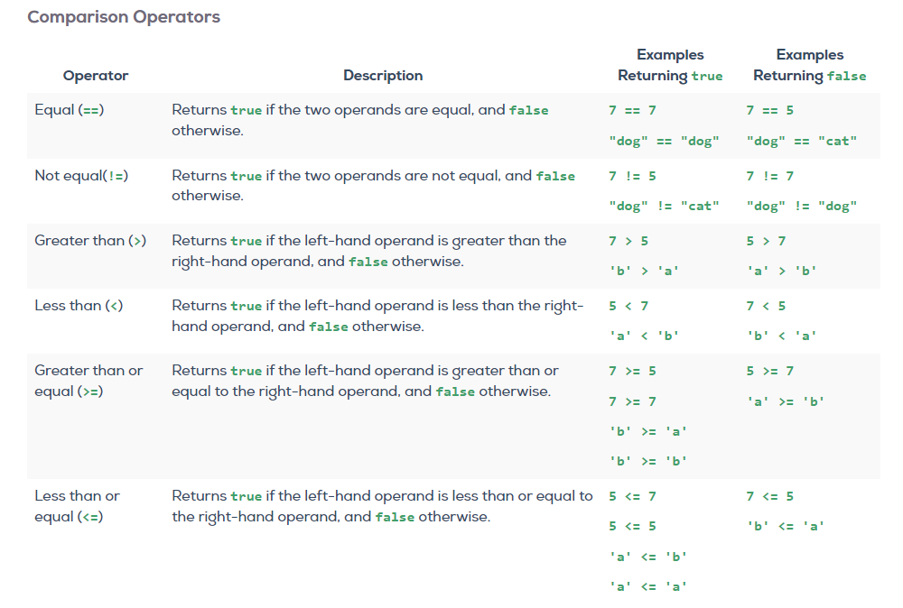

Slide 38
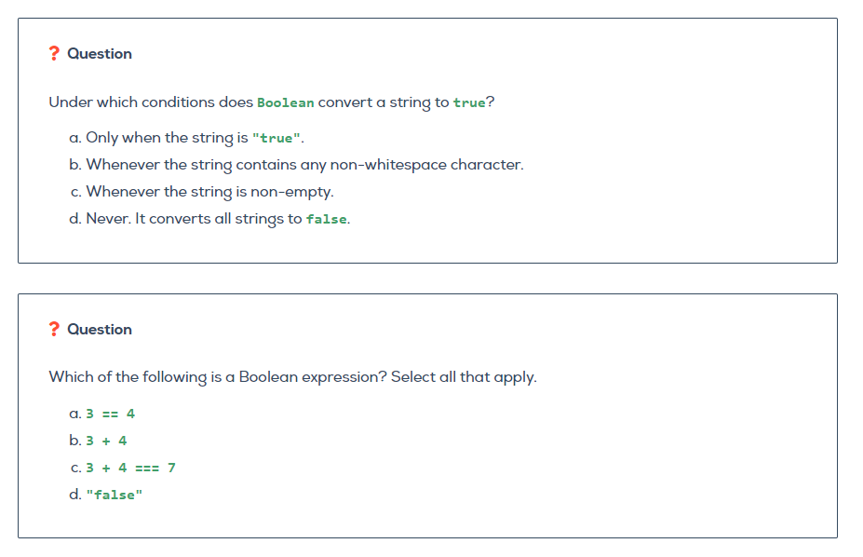

Slide 39
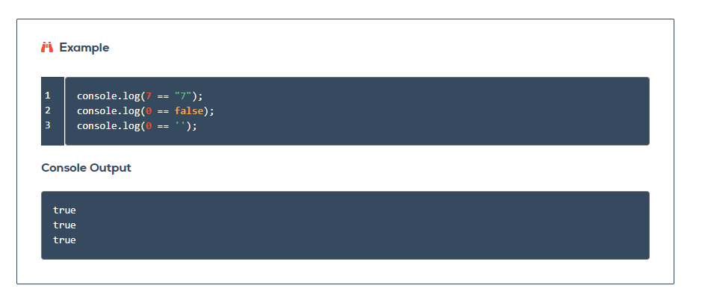
3. COMPARISON OPERATORS - Equality
Loose Equality:

Slide 40
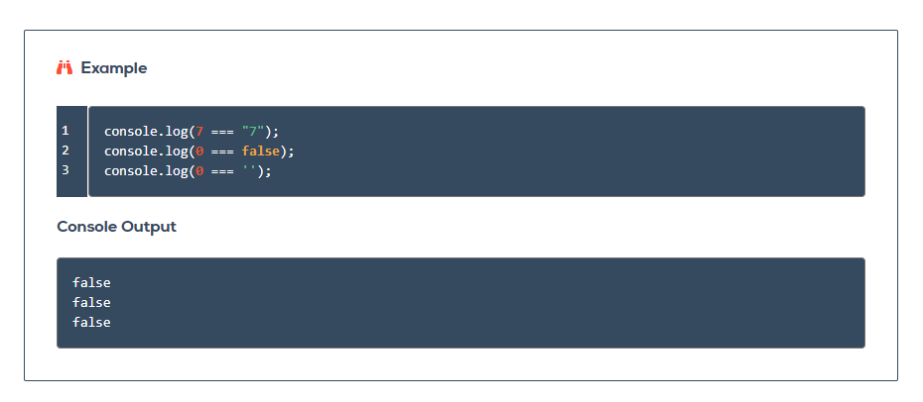
3. COMPARISON OPERATORS - Equality
2. Strict Equality:

Slide 41
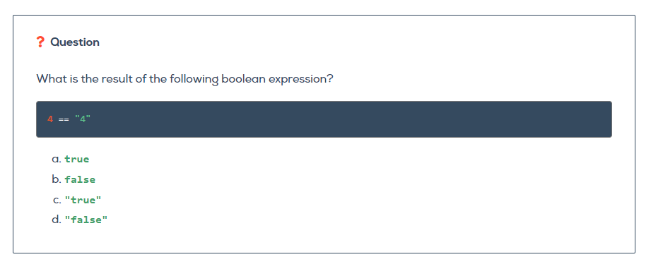

Slide 42
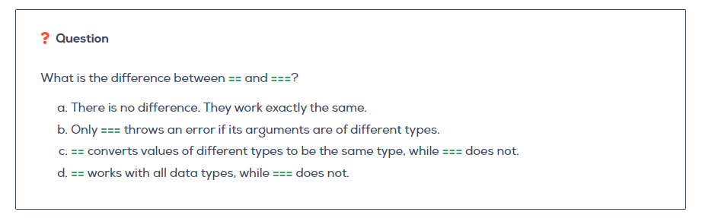

Slide 43
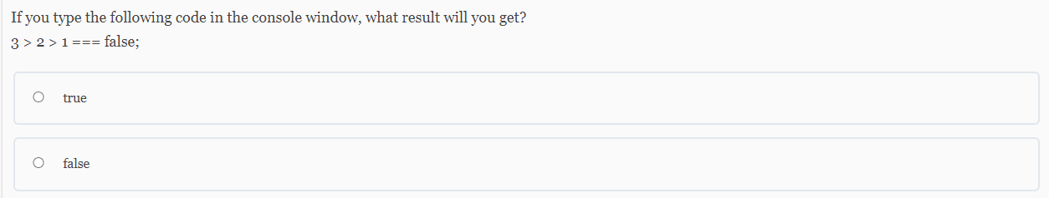

Slide 44
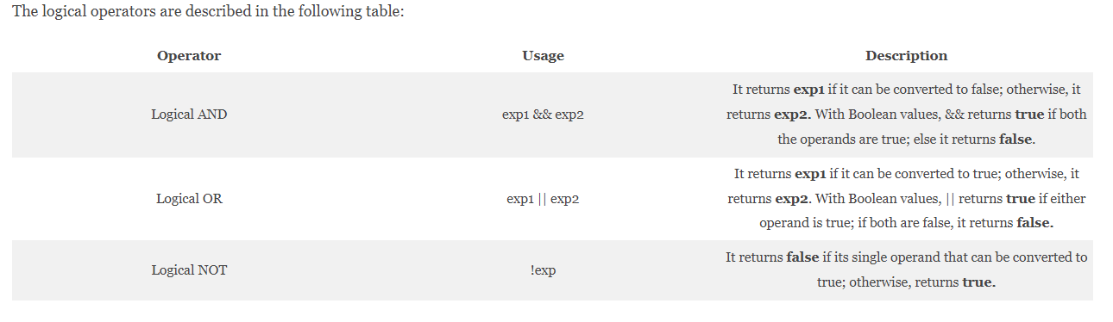
4. LOGICAL OPERATORS
These operators are (typically) used with Boolean/ logical values and return a Boolean value.

Slide 45
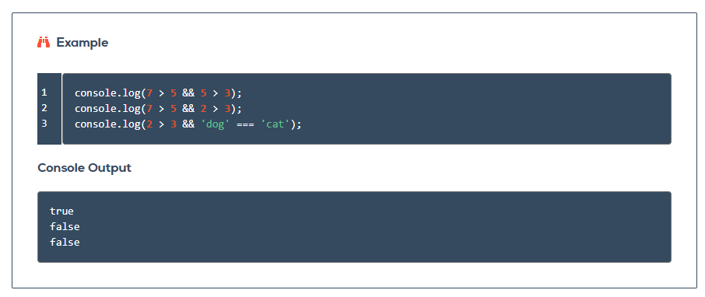
LOGICAL && OPERATOR (AND)
In English, the && operator mirrors the use of the word "and" (hence the name "logical AND"). A sentence like "Roses are red and violets are blue," is true as a whole precisely because roses are actually red, and violets are actually blue.
On the other hand, the sentence "Roses are red and violets are green," is false as a whole. While roses are indeed red, violets are not green.

Slide 46
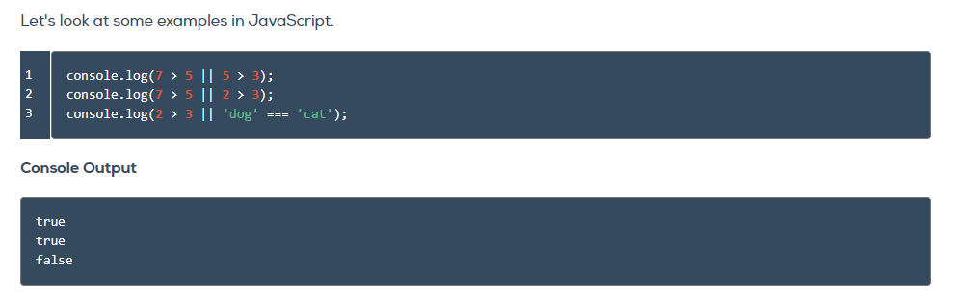
LOGICAL || OPERATOR (OR)
logical OR mirrors our experience of English language truth values. The sentence "Pigs can fly or dogs can run," is true as a whole. Joining the two clauses by "or" requires that only one of them is true in order for the full sentence to be true.
When both of the clauses joined by "or" are false, the statement as a whole is false. For example, "Pigs can fly or dogs can speak Spanish," is a false statement.

Slide 47
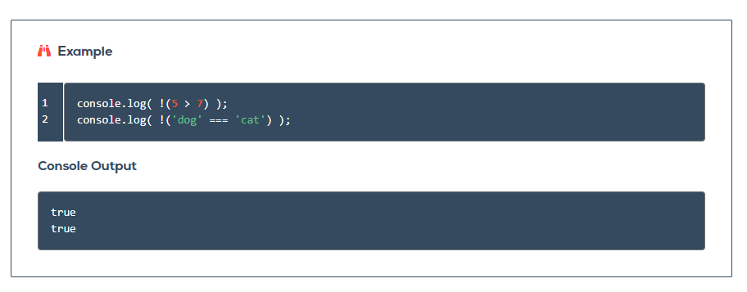
LOGICAL ! OPERATOR (NOT)
The logical NOT operator, !, takes only a single operand and reverses its boolean value.

Slide 48
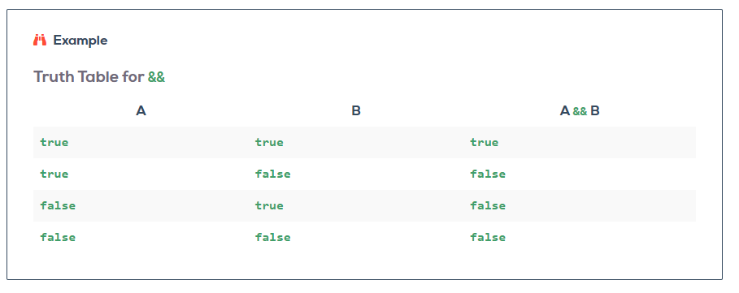
Truth Tables
Truth tables help us understand how logical operators work by calculating all of the possible return values of a boolean expression.

Slide 49
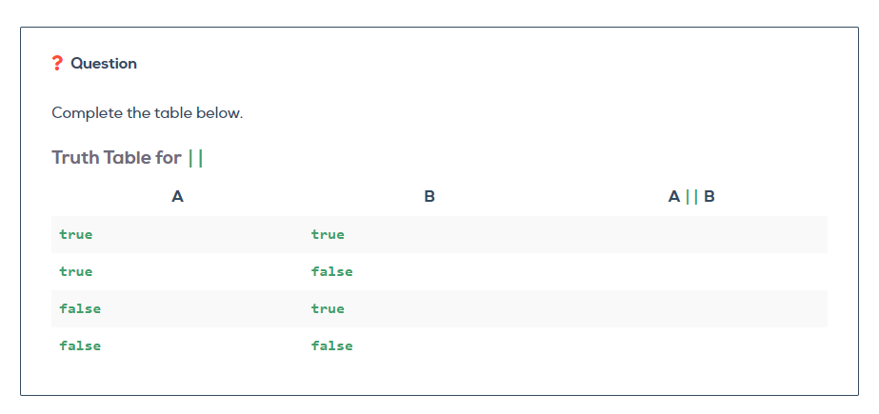
Truth Tables
Truth tables help us understand how logical operators work by calculating all of the possible return values of a boolean expression.

Slide 50
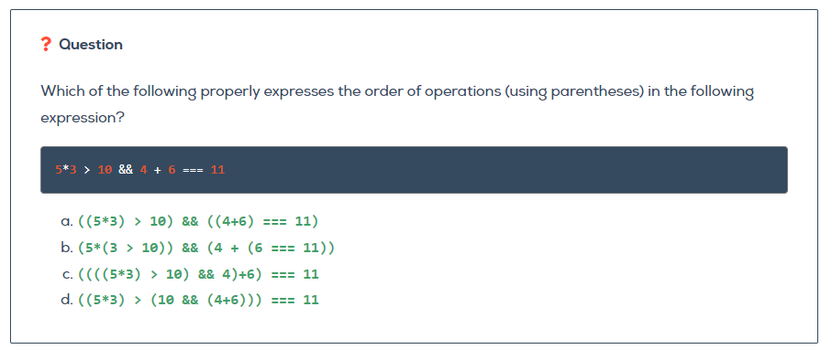

Slide 51
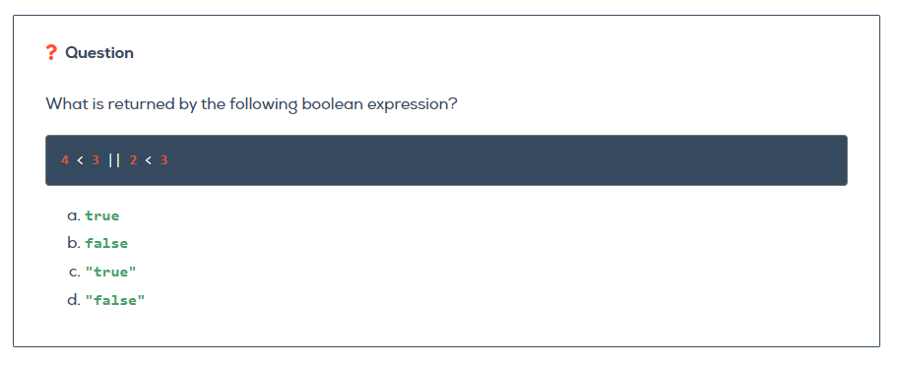

Slide 52
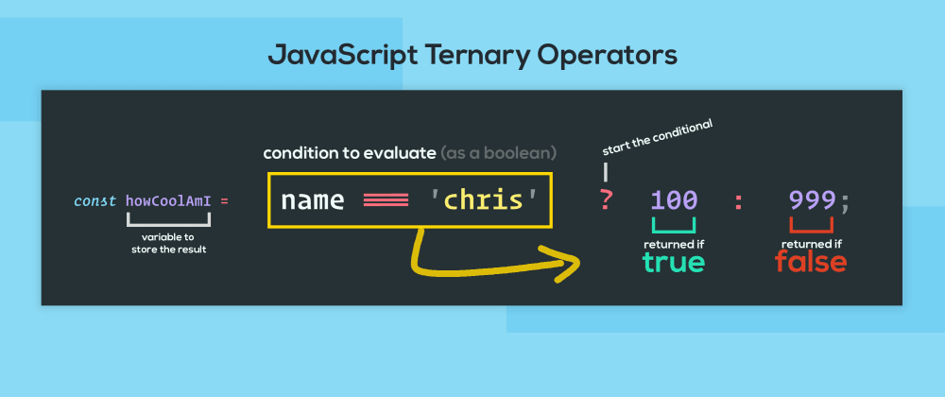
4. TENARY OPERATORS (?)
This is the only JavaScript operator that takes 3 operands. It assigns one of the two values to a variable based on some condition.
The syntax for this operator is: condition? val1: val2;
If the condition is true, this operator returns val1; else it returns val2. Programmers sometimes use this operator as an alternative to if…else statements.

Slide 53
JAVASCRIPT KEYWORDS

Slide 54
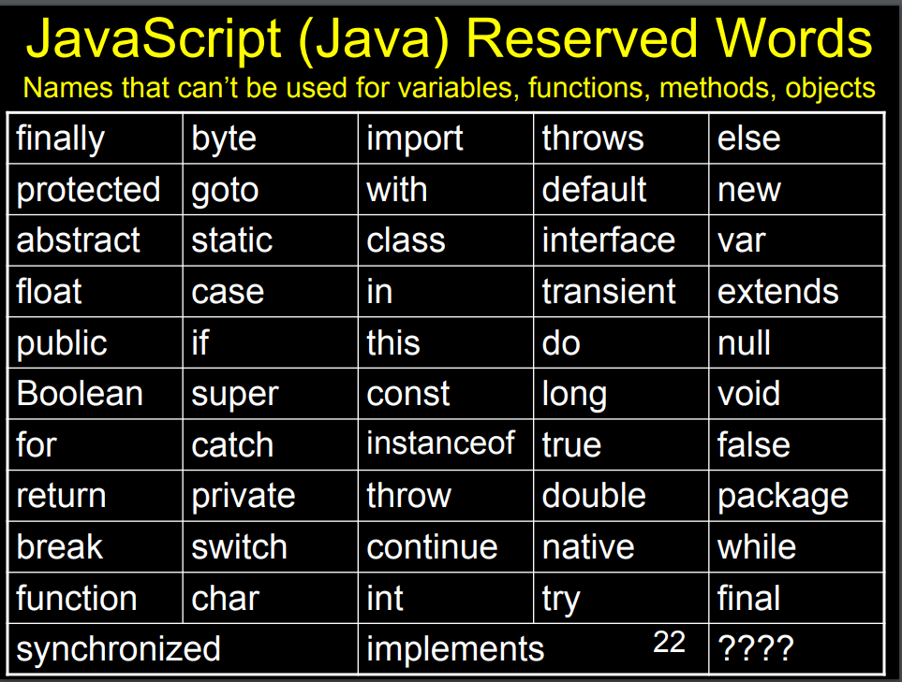

Slide 55
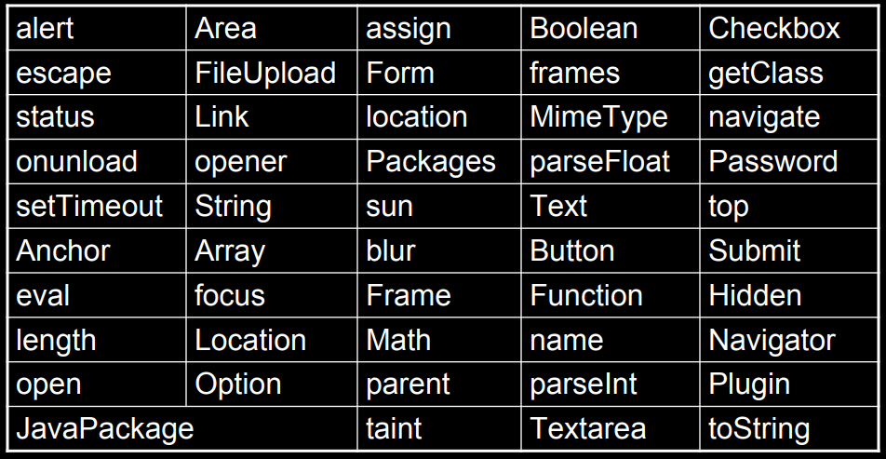

Slide 56
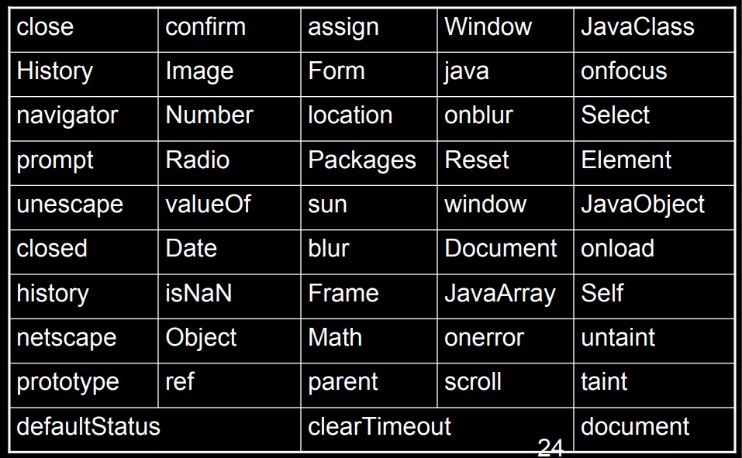

Slide 57
JAVASCRIPT EXPRESSIONS VS STATEMENTS

Slide 58
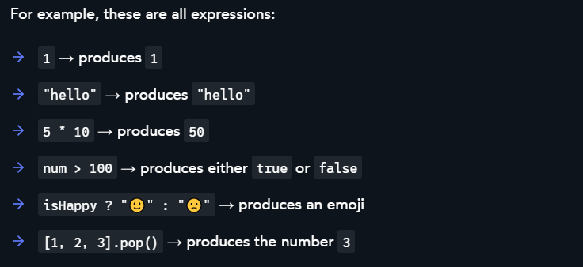
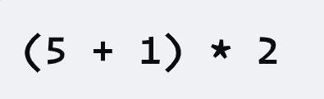
EXPRESSIONS
At its core, an expression is a bit of JavaScript code that produces a value.
Expressions can contain expressions. For example, how many expressions do you count in this chunk of JS code?

Slide 59
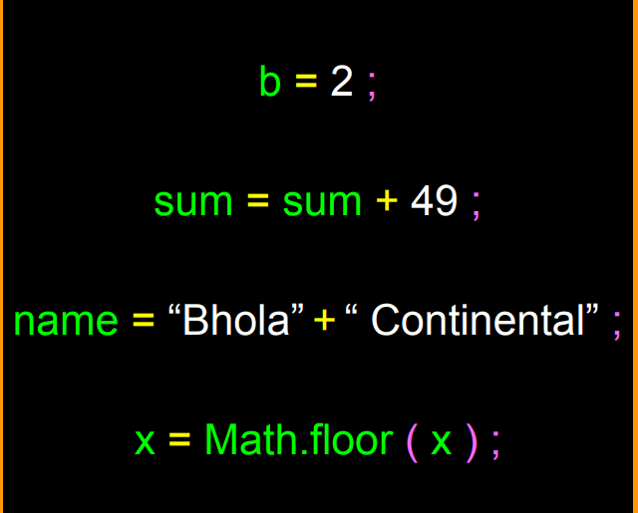
ELEMENTS OF EXPRESSIONS
Identifiers: JavaScript Keywords
Operators
Literals: A data value that appears directly in a statement
Punctuation

Slide 60
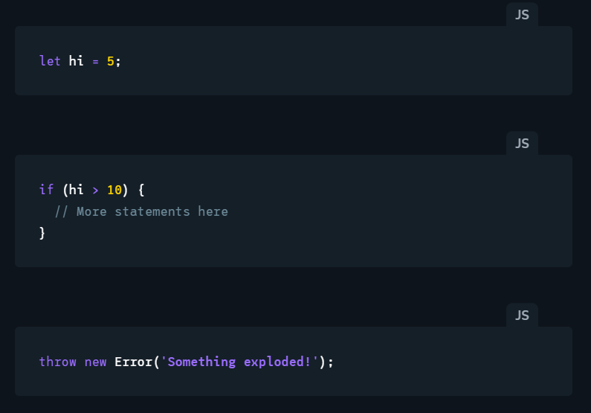
STATEMENTS
JavaScript program is a sequence of statements. Each statement is an instruction for the computer to do something.

Slide 61
EXPRESSIONS VS STATEMENTS
A JavaScript program consists of a sequence of statements.
Each statement is an instruction to do something, like create a variable, run an if/else condition, or start a loop.
Expressions produce a value, and these values are slotted into statements.
Expressions are always part of a statement, even if that statement is otherwise empty.

Slide 62
JAVASCRIPT FUNCTIONS
In JavaScript, everything is an object: Numbers, Strings and even functions.

Slide 63
FUNCTIONS
What are functions?
Using functions
Creating functions
Declarative function
Function expressions
Functions as values
Parameters
Calling Functions
Return Statement
Overloading
Function Scope
Why Functions

Slide 64
FUNCTIONS
A function is a reusable, callable piece of code.
Functions are actually objects in javascript.
Like variables, functions often have names.
They allow us to repeat actions without repeating each individual step of code that the actions are built from.
By grouping actions together, functions allow us to be removed from the details of what they are actually doing.
A commonly-used analogy for describing the concept of a function is that of a machine that takes input, carries out an action, and gives back a result. This is known as the function machine analogy.

Slide 65
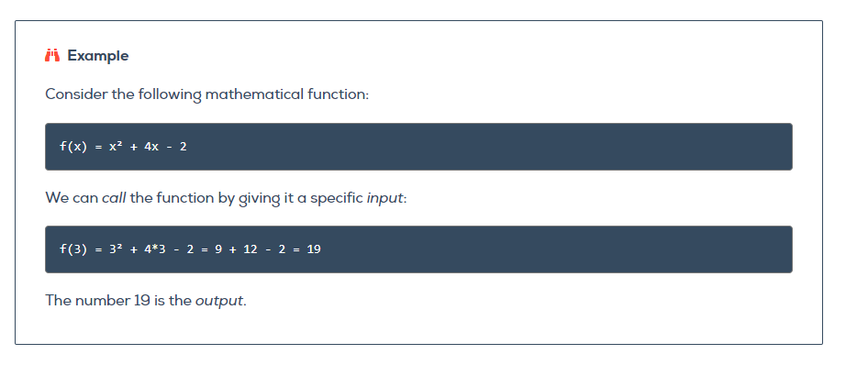
FUNCTIONS
A commonly-used analogy for describing the concept of a function is that of a machine that takes input, carries out an action, and gives back a result. This is known as the function machine analogy.

Slide 66
USING FUNCTIONS
A function call is the act of using a function by referring to its name, followed by parentheses.
A synonymous term is function invocation, and we will sometimes say that we are "invoking a function.“
A function call is the act of using a function by referring to its name, followed by parentheses.
A synonymous term is function invocation, and we will sometimes say that we are "invoking a function."

Slide 67
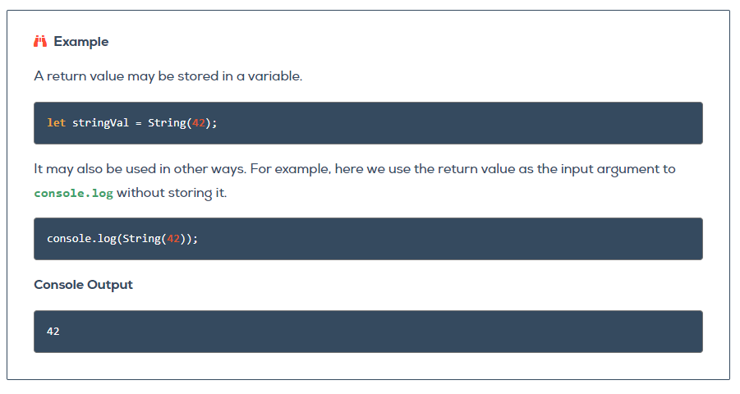
USING FUNCTIONS
Every function provides a return value, which can be used by the calling program---for example, to store in a variable or print to the console.

Slide 68
USING FUNCTIONS
In some cases, calling a function results in an action that changes the state of a program outside of the function itself. Such a behavior is known as a side effect.

Slide 69
CREATING FUNCTIONS
The most powerful aspect of functions is the ability of programmers to create their own.
There are several ways to define functions in JavaScript (Declaration & Expression)
Normal syntax (Function Declaration)
Function expressions (Anonymous functions)
Function as values
Arrow functions

Slide 70
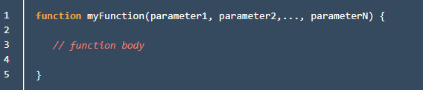
Delaring Function Syntax
Function is a keyword that instructs JavaScript to create a new function using the definition that follows
Following function is the function name, determined by the programmer, and should follow best practices. In particular, function names should use camel case and have descriptive names.
Following the function name, we define parameters within the parentheses. The number and names of the parameters are determined by the programmer, based on what they want the function to do. A function may be defined with several parameters, or no parameters at all.

Slide 71
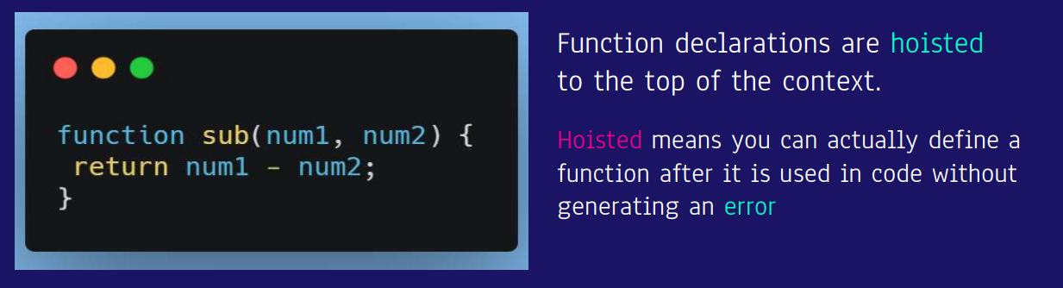
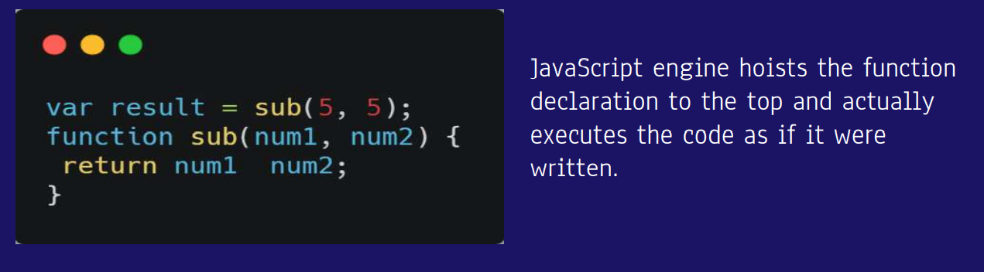
CREATING / DECLARING FUNCTIONS

Slide 72
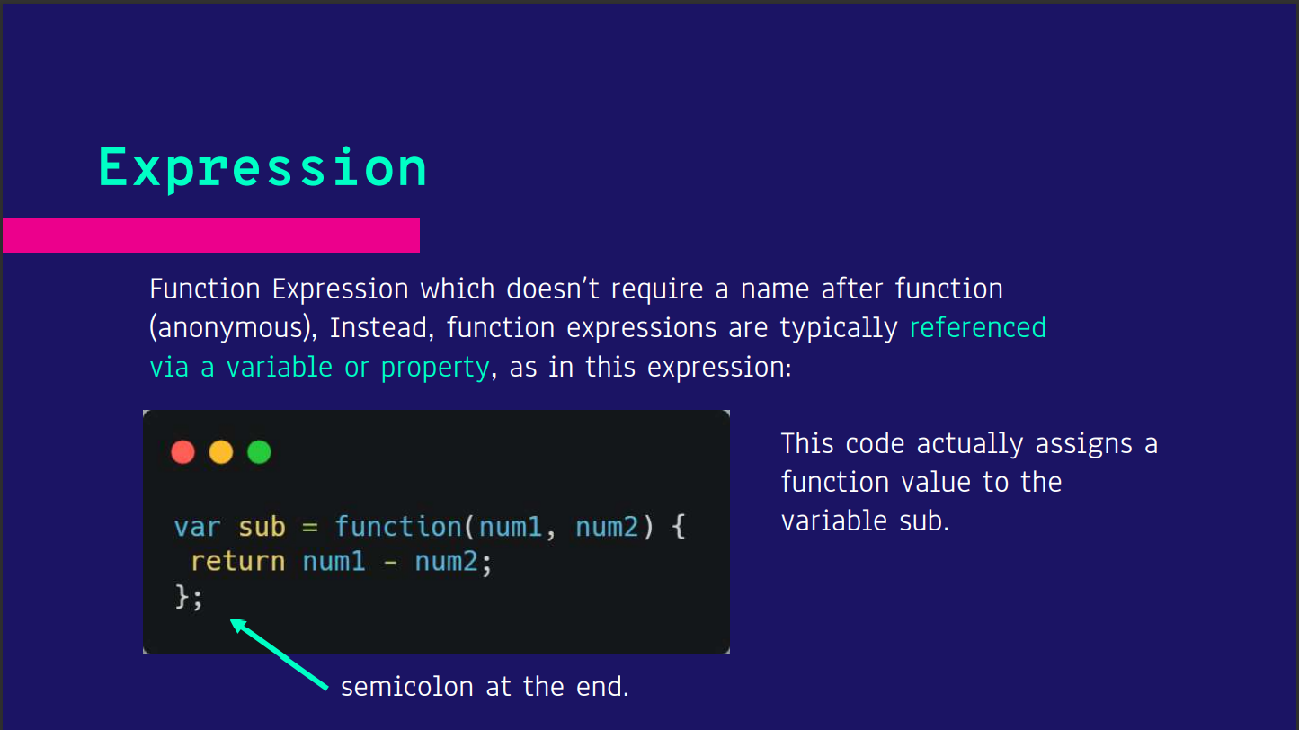

Slide 73
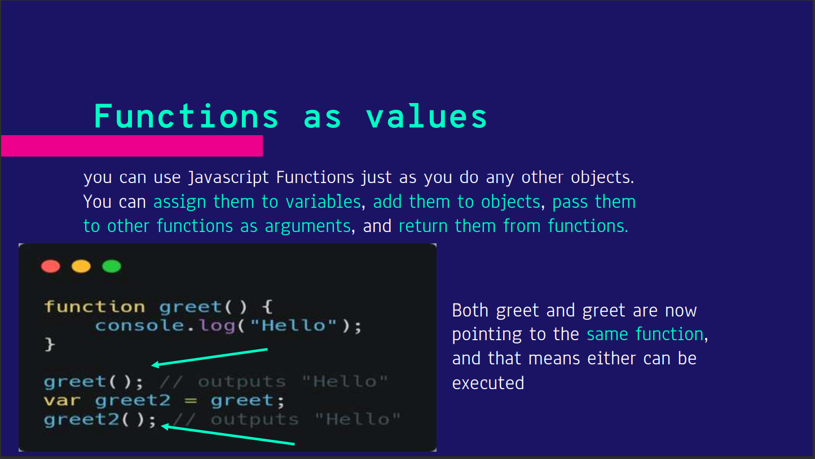

Slide 74
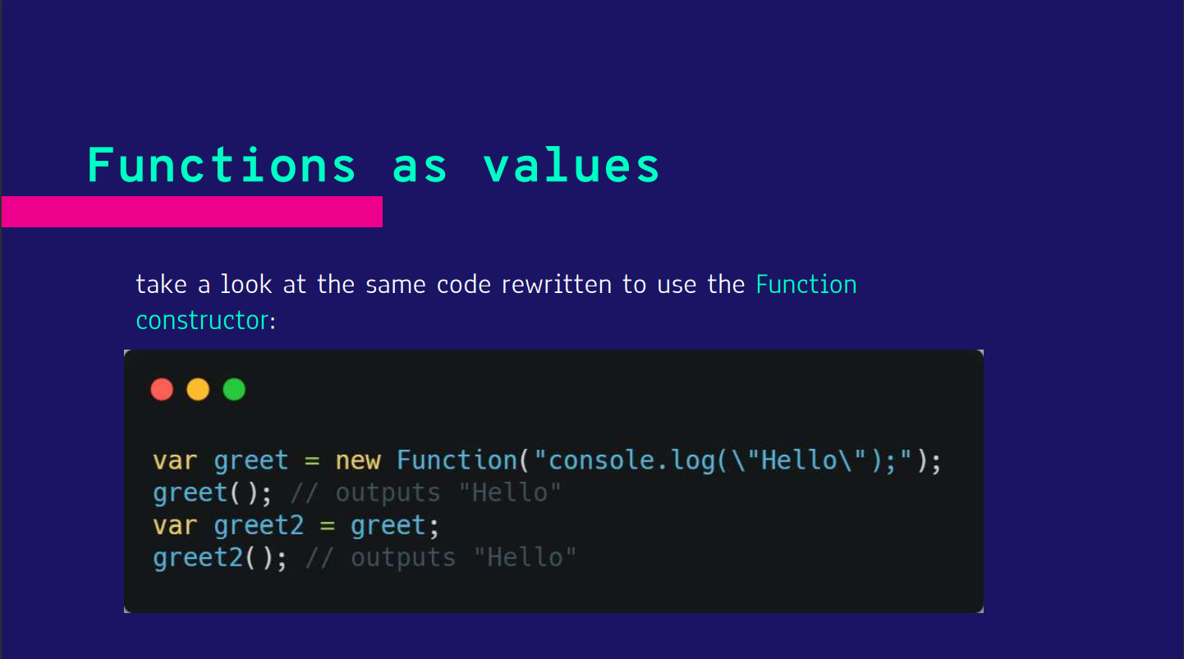

Slide 75


Slide 76


Slide 77


Slide 78
Return Statements
Some functions return values that are useful.
To return a value from functions that we create, we can use a return statement.
Using return is Optional
return Terminates Function Execution

Slide 79

Defining and Calling Functions
When we define a function, we are making it available for later use. The function does not execute when it is defined; it must be called in order to execute.

Slide 80
Defining and Calling Functions
When we define a function, we are making it available for later use. The function does not execute when it is defined; it must be called in order to execute.

Slide 81


Slide 82


Slide 83


Slide 84


Slide 85
Function scope
The scope of a variable is the extent to which a variable is visible within a program.
Scope consists of all locations within a program where a variable can be used or modified.
Introducing functions gives us one of our first examples of limited variable scope---a situation in which a variable is not visible throughout an entire program.

Slide 86

Function scope
The scope of a variable is the extent to which a variable is visible within a program.
Scope consists of all locations within a program where a variable can be used or modified.
Introducing functions gives us one of our first examples of limited variable scope---a situation in which a variable is not visible throughout an entire program.

Slide 87

The scope of a variable is the extent to which a variable is visible within a program.
Scope consists of all locations within a program where a variable can be used or modified.
Introducing functions gives us one of our first examples of limited variable scope---a situation in which a variable is not visible throughout an entire program.

Slide 88

The scope of a variable is the extent to which a variable is visible within a program.
Scope consists of all locations within a program where a variable can be used or modified.
Introducing functions gives us one of our first examples of limited variable scope---a situation in which a variable is not visible throughout an entire program.

Slide 89
Why Functions?
Functions Reduce Repetition
Functions Make Your Code More Readable
Functions Reduce Complexity
Functions Enable Code Sharing

Slide 90

CONDITIONS

Slide 91
Conditional Statements
The ability for your program to make decisions based on specified inputs
Examples are:
Using if statement
Using if else statement
Using else if statement
Ternary Operator
Switch statement

Slide 92

1. IF Statements

Slide 93

1. IF Statements

Slide 94

1. IF Statements

Slide 95

1. IF Statements

Slide 96

2. ELSE clause

Slide 97

2. ELSE clause

Slide 98
3. ELSE IF clause

Slide 99

3. ELSE IF clause

Slide 100

1. ELSE IF clause

Slide 101

1. ELSE IF clause

Slide 102

Nested Conditionals

Slide 103

Nested Conditionals
Solution Attempt 1:
Notes:
Wrong: Positive

Slide 104

Nested Conditionals
Solution Attempt 2:
Notes:
Correct

Slide 105

Nested Conditionals
Solution Attempt 2:
Notes:
Correct

Slide 106

Nested Conditionals
Solution Attempt 2:
Notes:
Correct

Slide 107
Class Activities (Functions)
Write a JavaScript function that accepts a number as a parameter and check the number is prime or not. Note : A prime number (or a prime) is a natural number greater than 1 that has no positive divisors other than 1 and itself.
Write a JavaScript function that reverse a number. Example x = 32243; Expected Output : 34223
Write a JavaScript function which accepts an argument and returns the type. Note : There are six possible values that typeof returns: object, boolean, function, number, string, and undefined.
Notes:
Correct

Slide 108
Class Activities (Conditionals)
Write a JavaScript program that accept two integers and display the larger
Write a JavaScript conditional statement to find the largest of five numbers. Display an alert box to show the result. Sample numbers : -5, -2, -6, 0, -1 Output : 0
https://education.launchcode.org/intro-to-professional-web-dev/chapters/booleans-and-conditionals/exercises.html
Notes:
Correct

Slide 109
DATA STRUCTURES (STRINGS)

Slide 110
RECAP ON STRINGS
we have used strings to represent words or phrases we wanted to print out. Our definition of a string was simple: a string is a sequence of characters inside quotes.
Data types that are comprised of smaller pieces are called collection data types, or simply collection types. Depending on what we are doing, we may want to treat a value of a collection data type as a single entity (the whole collection), or we may want to access its parts.
A character is a string that contains exactly one element, such as 'a', "?", or even " " (a single space character).
Notes:
Correct

Slide 111
Bracket Notation
Bracket notation is the special syntax that allows us to access the individual characters that make up a string.
To access a character, we use the syntax someString[i],
where i is the index of the character we want to access.
String indices are integers representing the position of a character within a given string, and they start at 0.
Thus, the first character of a string has index 0, the second has index 1, and so on
Notes:
Correct

Slide 112

Bracket Notation
Notes:
Correct

Slide 113

Bracket Notation
Notes:
Correct

Slide 114

Bracket Notation
Notes:
Correct

Slide 115

Bracket Notation
Notes:
Correct

Slide 116

Bracket Notation
Notes:
Correct

Slide 117

Objects
An object is a collection of related data and operations. An operation that can be carried out on an object is known as a method. A piece of data associated with an object is known as a property
Notes:
Correct

Slide 118

Object Methods
You can think of methods and properties as functions and variables, respectively, that "belong to" an object.
Properties and methods are accessed using dot notation, which dictates that we use the object name, followed by a ., followed by the property or method name.
When using a method, we must also use parentheses as we do when calling regular function
Notes:
Correct

Slide 119
Strings are Objects
Every string that we work with will have the same properties and methods. The most useful string property is named length, and it tells us how many characters are in a string
Notes:
Correct

Slide 120

Strings are Objects
Notes:
Correct

Slide 121

Strings Immutability
If an object cannot be changed, we say that it is immutable. Strings are immutable, which means we cannot change the individual characters within a given string. While we can access individual characters using bracket notation, attempting to change individual characters simply does not work
Notes:
Correct

Slide 122

Strings Immutability
We can however change the whole string
Notes:
Correct

Slide 123

Strings Methods
JavaScript provides many useful methods for string objects. Recall that a method is a function that "belongs to" a specific object.
Notes:
Correct

Slide 124

Strings Methods
JavaScript provides many useful methods for string objects. Recall that a method is a function that "belongs to" a specific object.
Notes:
Correct

Slide 125

Strings Methods
JavaScript provides many useful methods for string objects. Recall that a method is a function that "belongs to" a specific object.
Notes:
Correct

Slide 126

Strings Methods
JavaScript provides many useful methods for string objects. Recall that a method is a function that "belongs to" a specific object.
Notes:
Correct

Slide 127

Strings Methods
JavaScript provides many useful methods for string objects. Recall that a method is a function that "belongs to" a specific object.
Notes:
Correct

Slide 128
Strings Exersice
https://education.launchcode.org/intro-to-professional-web-dev/chapters/strings/exercises.html
Notes:
Correct

Slide 129
DATA STRUCTURES (ARRAYS)

Slide 130

ARRAYS
Arrays are similar to strings, but are a more general collection type. Like strings, arrays are a sequence of values that can be accessed via an ordered index. Unlike strings, arrays can store data of any type
Notes:
Correct

Slide 131
Declaring Arrays
Programmers use multiple ways to declare a new array.
The simplest way is to use array literal notation [].
Anything enclosed in the square brackets will be items in the array.
Each item should be followed by a comma ,.
If there are no items inside the brackets, then the array is considered empty
Notes:
Correct

Slide 132

Declaring Arrays
Programmers use multiple ways to declare a new array.
The simplest way is to use array literal notation [].
Anything enclosed in the square brackets will be items in the array.
Each item should be followed by a comma ,.
If there are no items inside the brackets, then the array is considered empty
Notes:
Correct

Slide 133
Declaring Arrays
Programmers use multiple ways to declare a new array.
The simplest way is to use array literal notation [].
Anything enclosed in the square brackets will be items in the array.
Each item should be followed by a comma ,.
If there are no items inside the brackets, then the array is considered empty
Notes:
Correct

Slide 134

Array Length
Programmers use multiple ways to declare a new array.
The simplest way is to use array literal notation [].
Anything enclosed in the square brackets will be items in the array.
Each item should be followed by a comma ,.
If there are no items inside the brackets, then the array is considered empty
Notes:
Correct

Slide 135

Array Length
Programmers use multiple ways to declare a new array.
The simplest way is to use array literal notation [].
Anything enclosed in the square brackets will be items in the array.
Each item should be followed by a comma ,.
If there are no items inside the brackets, then the array is considered empty
Notes:
Correct

Slide 136

Working with Arrays
Notes:
Correct

Slide 137

Working with Arrays
Notes:
Correct

Slide 138
Arrays are Mutable
Mutability refers to what happens when you attempt to change a value
In contrast to Strings, arrays are mutable, meaning that individual items in an array can be edited without a new array being created.
Notes:
Correct

Slide 139

Arrays are Mutable
mutability refers to what happens when you attempt to change a value
In contrast to Strings, arrays are mutable, meaning that individual items in an array can be edited without a new array being created.
Notes:
Correct

Slide 140

Arrays Methods
mutability refers to what happens when you attempt to change a value
In contrast to Strings, arrays are mutable, meaning that individual items in an array can be edited without a new array being created.
Notes:
Correct

Slide 141

Arrays Methods
Notes:
Correct

Slide 142

Arrays Methods
Notes:
Correct

Slide 143

Arrays Methods
Notes:
Correct

Slide 144

Arrays Methods
Notes:
Correct

Slide 145

Arrays Methods
Notes:
Correct

Slide 146

Arrays Methods
Notes:
Correct

Slide 147

Multi dimensional Arrays
A multi-dimensional array is an array of arrays, meaning that the values inside the array are also arrays.
The inner arrays can store other values such as strings, numbers, or even more array.
Notes:
Correct

Slide 148
Two Dimensional Arrays
The simplest form of a multi-dimensional array is a two dimensional array.
A two dimensional array is like a spreadsheet with rows and columns.
To access items in a two dimensional array, use square bracket notation and two indexes array[0][0].
The first index is for the outer array, or the "row", and second index is for the inner array, or the "column".
Notes:
Correct

Slide 149

Two Dimensional Arrays
Notes:
Correct

Slide 150

Two Dimensional Arrays
Notes:
Correct

Slide 151

Two Dimensional Arrays
Notes:
Correct

Slide 152
Array Exercise
https://education.launchcode.org/intro-to-professional-web-dev/chapters/arrays/exercises.html
Notes:
Correct

Slide 153
String & Array Exercise
https://education.launchcode.org/intro-to-professional-web-dev/chapters/arrays/studio.html
Notes:
Correct

Slide 154
LOOPS

Slide 155
Iterations
When repeating the same action over and over again, a human is likely to make a mistake. Computers, however, possess the incredible ability to carry out repetitive tasks without making mistakes.
Learning about iteration using loops is also an opportunity to introduce one of the most widely-known mnemonic devices in programming: Don't Repeat Yourself, or DRY. A common piece of advice from instructors and experienced programmers is that you should "keep your code DRY.“
Types of Loops include:
For loops
While loops
Break … Continue
Notes:
Correct

Slide 156


For Loops
A for loop is typically used for definite iteration.
Definite iteration is the process of repeating a specific task with a specific data set.
When a for loop begins it can usually be determined exactly how many times it will execute: once for each item in the data set.
Notes:
Correct

Slide 157
For Loops Anatomy
Initial Expression:
The initial expression is executed once, before any iterations of the loop. It can be any expression, even the empty expression (which contains no code). However, it almost always declares and initializes a variable, known as the loop variable
Notes:
Correct

Slide 158
For Loops Anatomy
2. Loop Condition:
The loop condition is executed before each loop iteration. It is always a boolean expression, evaluating to true or false. If the condition is true, the loop body executes. If the condition is false, loop execution stops and the program continues with the next line of code below the loop
Notes:
Correct

Slide 159
For Loops Anatomy
2. Update Expression:
This expression executes after every iteration of the loop. While this expression may be anything, it most often updates the value of the loop variable
Notes:
Correct

Slide 160

For Loops
Notes:
Correct

Slide 161

Iterating on Strings
Notes:
Correct

Slide 162

Iterating on Arrays
Notes:
Correct

Slide 163

Example
Notes:
Correct

Slide 164


Example
Notes:
Correct

Slide 165

Example
Notes:
Correct

Slide 166

Notes:
Correct

Slide 167

Notes:
Correct

Slide 168

Notes:
Correct

Slide 169

While Loops
A while loop will continue to repeat as long as its boolean expression evaluates to true. The condition typically includes a value or variable that is updated within the loop, so that the expression eventually becomes false
Notes:
Correct

Slide 170

While Loops
Notes:
Correct

Slide 171
While Loops
A while loop will continue to repeat as long as its boolean expression evaluates to true. The condition typically includes a value or variable that is updated within the loop, so that the expression eventually becomes false
Notes:
Correct

Slide 172

While Loops
Notes:
Correct

Slide 173

While Loops
Notes:
Correct

Slide 174

Terminating a loop with BREAK
The break keyword, when used within a loop, will immediately terminate the execution of any loop
Notes:
Correct

Slide 175

Terminating a loop with BREAK
The break keyword, when used within a loop, will immediately terminate the execution of any loop
Notes:
Correct

Slide 176
Choosing which Loop to use?
The for loop is typically used to iterate through a fixed set of values that can be determined before the loop executes (Definite loop Iteration)
The while loop is more flexible, used when you cant determine how many times a loop would execute (Indefinite iteration)
Notes:
Correct

Slide 177

Choosing which Loop to use?
The for loop is typically used to iterate through a fixed set of values that can be determined before the loop executes (Definite loop Iteration)
The while loop is more flexible, used when you cant determine how many times a loop would execute (Indefinite iteration)
Notes:
Correct

Slide 178

Choosing which Loop to use?
The for loop is typically used to iterate through a fixed set of values that can be determined before the loop executes (Definite loop Iteration)
The while loop is more flexible, used when you cant determine how many times a loop would execute (Indefinite iteration)
Notes:
Correct

Slide 179
Loops Exercise 2
https://education.launchcode.org/intro-to-professional-web-dev/chapters/loops/studio.html
Notes:
Correct

Slide 180
Class Activities (Conditionals)
Write a JavaScript program that accept two integers and display the larger
Write a JavaScript conditional statement to find the largest of five numbers. Display an alert box to show the result. Sample numbers : -5, -2, -6, 0, -1 Output : 0
Notes:
Correct

Slide 181
Class Activities (Functions)
Write a JavaScript function that accepts a number as a parameter and check the number is prime or not. Note : A prime number (or a prime) is a natural number greater than 1 that has no positive divisors other than 1 and itself.
Write a JavaScript function that reverse a number. Example x = 32243; Expected Output : 34223
Write a JavaScript function which accepts an argument and returns the type. Note : There are six possible values that typeof returns: object, boolean, function, number, string, and undefined.
Notes:
Correct

Slide 182
Group Assignment for the Week
Read up on the following Topic
Numbers and Number Methods (Peter and Daniel)
Switch Conditional Statement (Adetola and Daniel)
Do While Loops (Paul and Cecilia)
Try…Catch Statement (Chisom, Seun, Chukwuebuka)
Notes:
Correct

